Slide 1
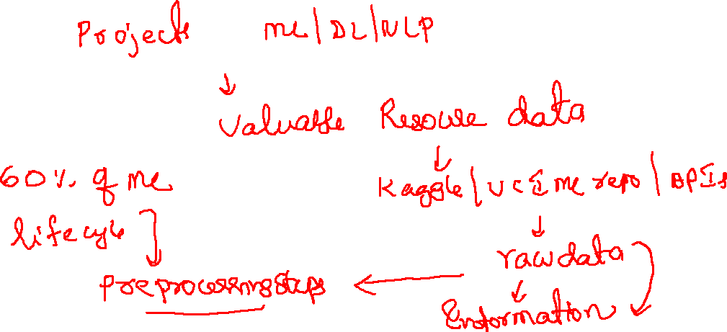
Machine Learning
Data Preprocessing

Slide 2

Steps in Data Science
Problem Identification
Data Collection/Generation
Data Preprocessing
Data Exploration (EDA)
Model Building
Model Evaluation
Analyze Results
Data Wrangling / Munging
Data Imputation
Data Integration
Data Encoding / Decoding
Outlier Analysis
Data Transformation / Normalization
Dimensionality Reduction
Feature Engineering

Slide 3
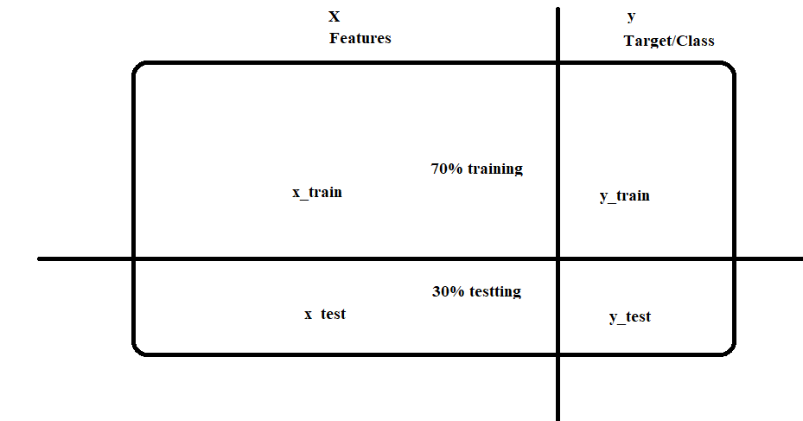
Vocabulary
Target: Predicted category or value of the data (discrete / continuous)
Column to be predicted
Response, Output, Dependent Variable, Labels
Features: Properties of the data used for prediction
Non-Target columns
Predictors, Input, Independent var, attributes
Example: a single data point within the data (one row)
Observations, Record, Instance, row, data points
Label: The target value for a single data point
answer, Category, Y axis

Slide 4
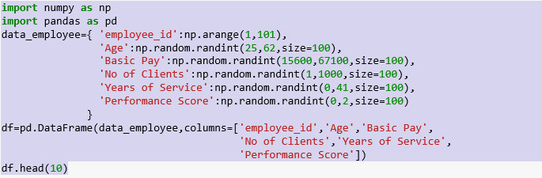
Data Generation
Range of this attributes are as follows:
Employee_id : 1-100
Age : 25-62
Basic pay : 15,600-67000
No.of clients :1-1000
Years of Services :0-40
Performance Score:0/1

Slide 5
Data Imputation
Many real-world datasets may contain missing values for various reasons. They are often encoded as NaNs, blanks or any other placeholders.
Rule 1: Discrete/Continuous values will be imputed with mean/median/standard deviation
Rule 2: Categorical values will be imputed with mode.
e1['Age'].fillna(e['Age'].mean(),inplace=True)
e1['Basic Pay'].fillna(e['Basic Pay'].mean(),inplace=True)
e1['No of Clients'].fillna(e['No of Clients'].mean(),inplace=True)
e1['Years of Service'].fillna(e['Years of Service'].mean(),inplace=True)
print(e1.head(5))

Slide 6
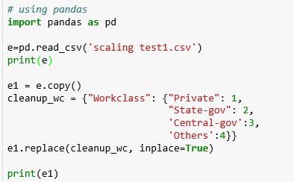
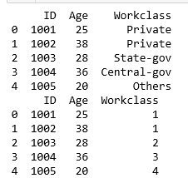
Data Encoding
Most of Machine Learning libraries represent data in numerical values rather than categorical values.
import “LabelEncoder” class from “sklearn.preprocessing” library and create an object labelencoder_X of the LabelEncoder class. After that use the fit_transform method on the categorical features.
One hot encoding transforms categorical features to a format that works better with classification and regression algorithms.

Slide 7
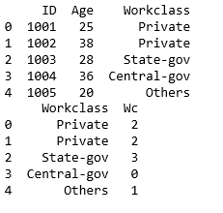
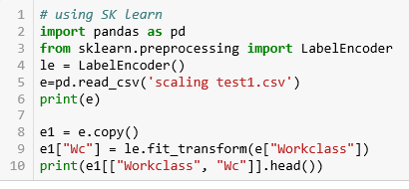
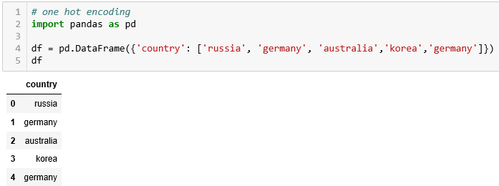
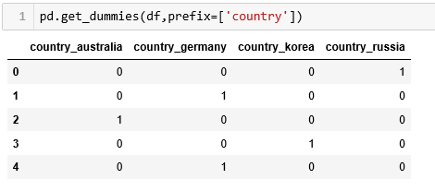
Data Encoding

Slide 8
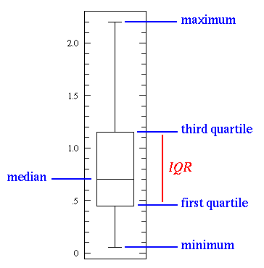
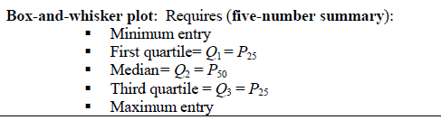
Outlier Detection
Outliers are not just greatest and least values, but values that are very different from the pattern established by the rest of the data. Outliers affect the mean.

Slide 9
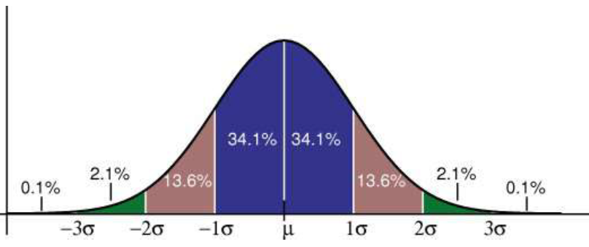
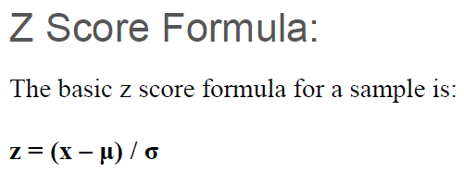

Data Normalization
A normal distribution, sometimes called the bell curve, is a distribution that occurs naturally in many situations.
The empirical rule tells you what percentage of your data falls within a certain number of standard deviations from the mean:
68% of the data falls within one standard deviation of the mean.
95% of the data falls within two standard deviations of the mean.
99.7% of the data falls within three standard deviations of the mean.

Slide 10
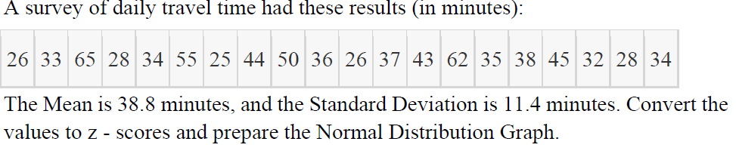
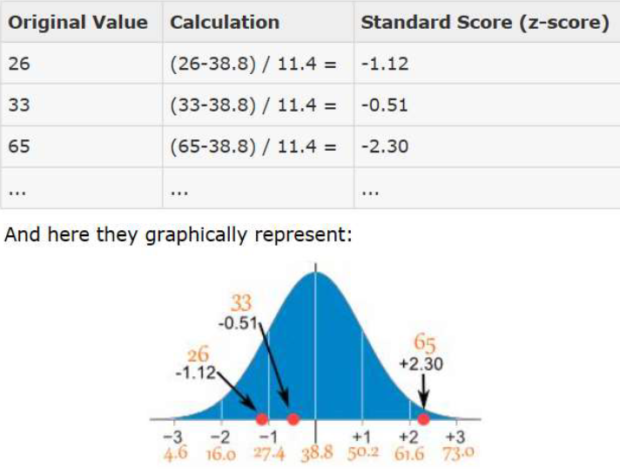

Slide 11
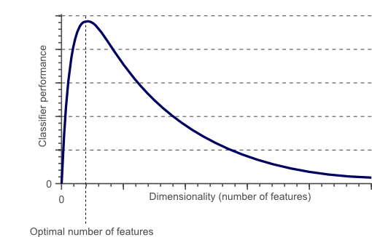
Dimensionality Reduction
As the number of features increases, the model becomes more complex.
The more the number of features, the more the chances of overfitting.
PCA/LDA/SVD are examples
A machine learning model that is trained on many features, gets increasingly dependent on the data it was trained on and in turn overfitted, resulting in poor performance on real data, beating the purpose.

Slide 12
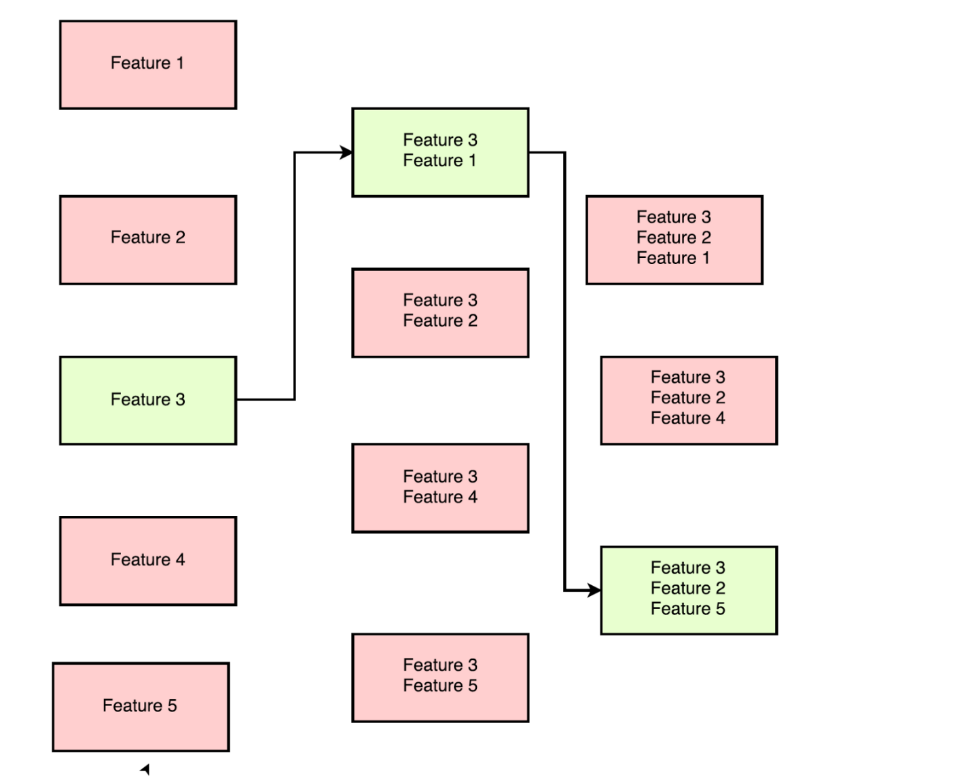
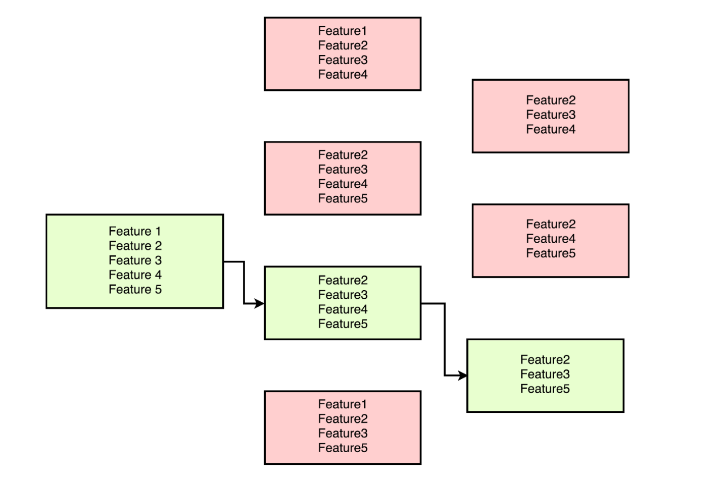
Feature Selection and Engineering
Feature selection is the process of identifying and selecting relevant features for your sample.
Feature engineering is manually generating new features from existing features, by applying some transformation or performing some operation on them.

Slide 13
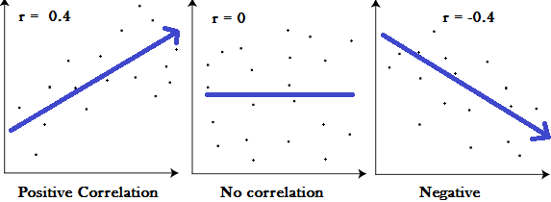
Covariance and correlation
Covariance provides insight into how two variables are related to one another.
Correlation tells that at what degree two or more variables are related.

Slide 14
Steps in Data Science
Problem Identification
Data Collection/Generation
Data Preprocessing
Data Exploration (EDA)
Model Building
Model Evaluation
Analyze Results
Data Wrangling / Munging
Data Imputation
Data Integration
Data Encoding / Decoding
Outlier Analysis
Data Transformation / Normalization
Dimensionality Reduction
Feature Engineering/Selection
Feature selection is the process of identifying and selecting relevant features for your sample.
Feature engineering is manually generating new features from existing features, by applying some transformation or performing some operation on them.

Slide 15
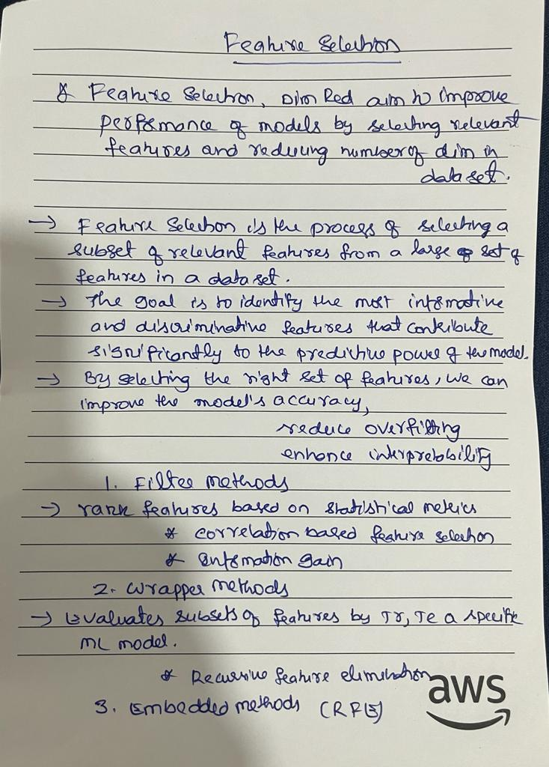

Slide 16
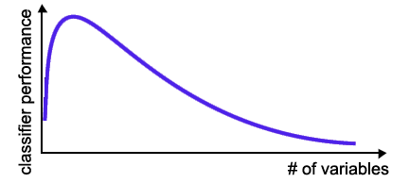
Curse of Dimensionality
number of training examples is fixed
  => the classifier’s performance usually will degrade for a large number of features!
Curse of dimensionality also describes the phenomenon where the feature space becomes increasingly sparse for an increasing number of dimensions of a fixed-size training dataset.
Intuitively, we can think of even the closest neighbors being too far away in a high-dimensional space to give a good estimate.

Slide 17
Feature Reduction in ML
Irrelevant and
redundant features
  can confuse learners.
Limited training data.
Limited computational resources.
Curse of dimensionality.

Slide 18
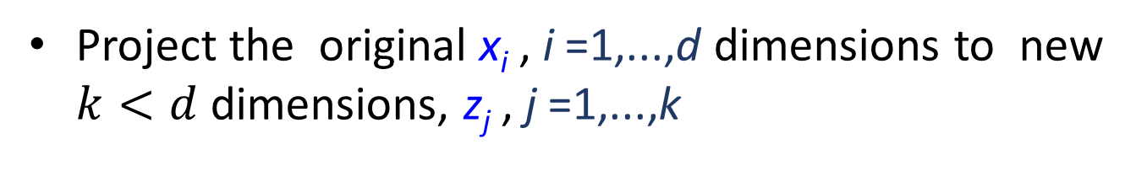
Feature Selection
Problem of selecting some subset of features, while ignoring the rest
Feature Extraction
Project the original x_{i} , i =1,...,d dimensions to new $k<d$dimensions, z_{j} , j =1,...,k
Criteria for selection/extraction:
either improve or maintain the classification accuracy, simplify classifier complexity.

Slide 19
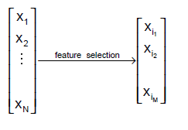

Feature Selection - Definition
Given a set of features $F=\{x_{1}, …,x_{n}\}$
  the Feature Selection problem is
  to find a subset $F′⊆F$ that maximizes the learners
  ability to classify patterns.
Formally $F′$ should maximize some scoring function

Slide 20
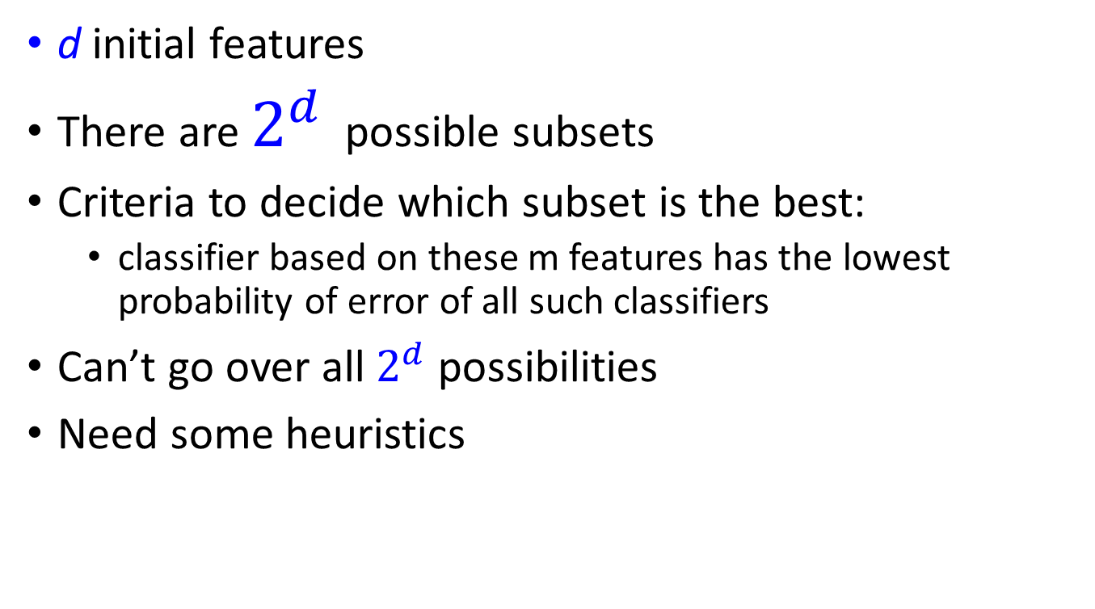
Subset selection
d initial features
There are $2^{d}$ possible subsets
Criteria to decide which subset is the best:
  classifier based on these m features has the lowest probability of error of all such classifiers
Can’t go over all $2^{d}$ possibilities
Need some heuristics

Slide 21
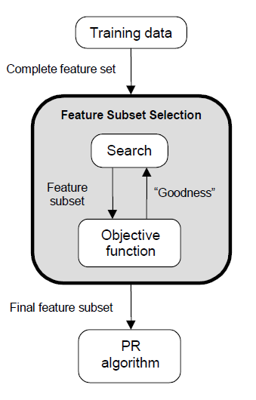
Feature Selection Steps
Feature selection is an optimization problem.
Step 1: Search the space of possible feature subsets.
Step 2: Pick the subset that is optimal or near-optimal with respect to some objective function.

Slide 22
Evaluating feature subset
Supervised (wrapper method)
  Train using selected subset
  Estimate error on validation dataset
Unsupervised (filter method)
  Look at input only
  Select the subset that has the most information

Slide 23
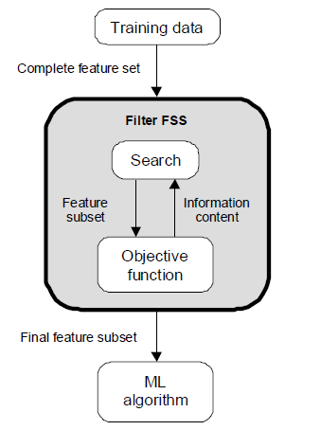
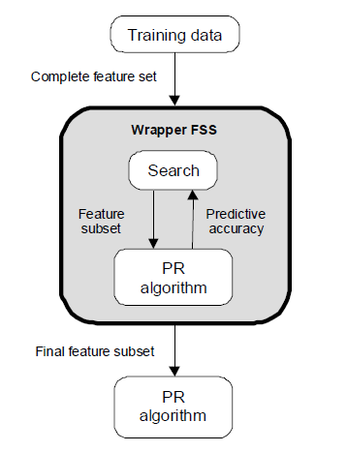
Evaluation Strategies
Filter Methods
Wrapper Methods

Slide 24
Subset selection
Select uncorrelated features
Forward search
  Start from empty set of features
  Try each of remaining features
  Estimate classification/regression error for adding specific feature
  Select feature that gives maximum improvement in validation error
  Stop when no significant improvement
Backward search
  Start with original set of size d
  Drop features with smallest impact on error

Slide 25
Feature selection
Univariate (looks at each feature independently of others)
  Pearson correlation coefficient
  F-score
  Chi-square
  Signal to noise ratio
  mutual information
  Etc.
Rank features by importance
Ranking cut-off is determined by user
Univariate methods measure some type of correlation between two random variables
the label (y_{i}) and a fixed feature (x_{ij} for fixed j)

Slide 26

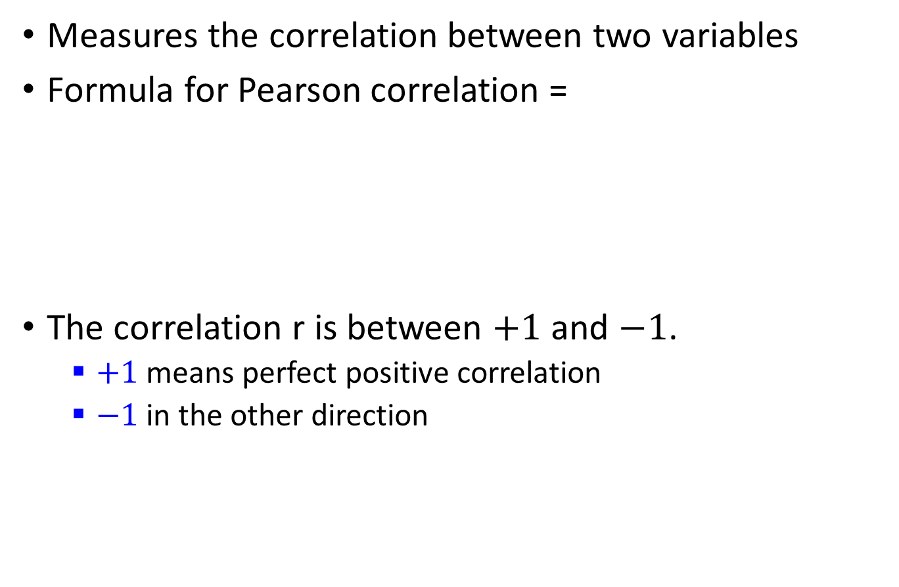
Pearson correlation coefficient
Measures the correlation between two variables
Formula for Pearson correlation =
The correlation r is between $+1$ and $−1$.
  $+1$ means perfect positive correlation
  $−1$ in the other direction

Slide 27
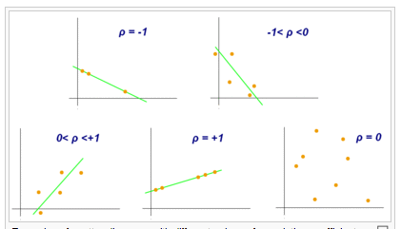
Pearson correlation coefficient
From Wikipedia

Slide 28
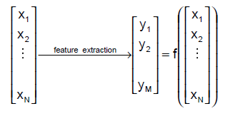
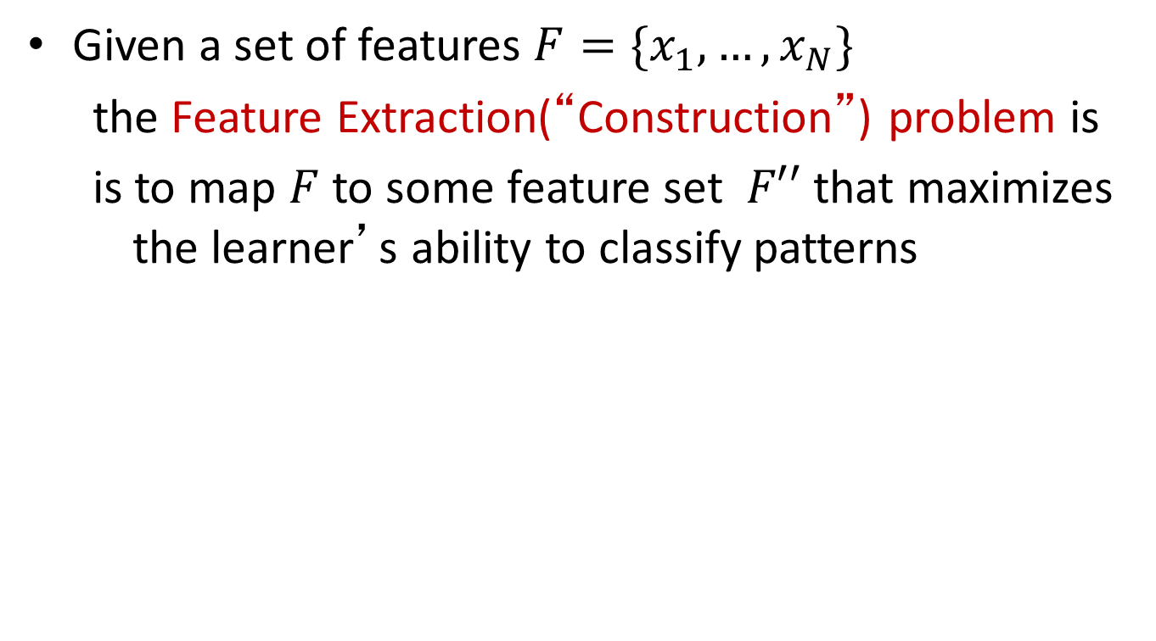
Feature extraction - definition
Given a set of features $F=\{x_{1}, …,x_{N}\}$
  the Feature Extraction(“Construction”) problem is
  is to map $F$ to some feature set $F′′$ that maximizes the learner’s ability to classify patterns

Slide 29
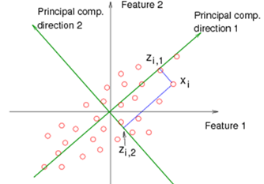
PCA

